Slide 1


E-Commerce Website Testing
IGATE is now a part of Capgemini

Slide 2
TEAM MEMBERS
Bilwa Pelapkar
Bineet Jaiswal
Chinmayee Khadapkar
Kavita Maurya
Rajib Ghosh

Slide 3
OVERVIEW OF THE PROJECT
This project is about an e-commerce clothing website.
Website allows user to view products and allows them to purchase it if interested.
It’s a shopping site which is designed for shopping of women clothing.
The Application link is: http://www.automationpractice.com

Slide 4
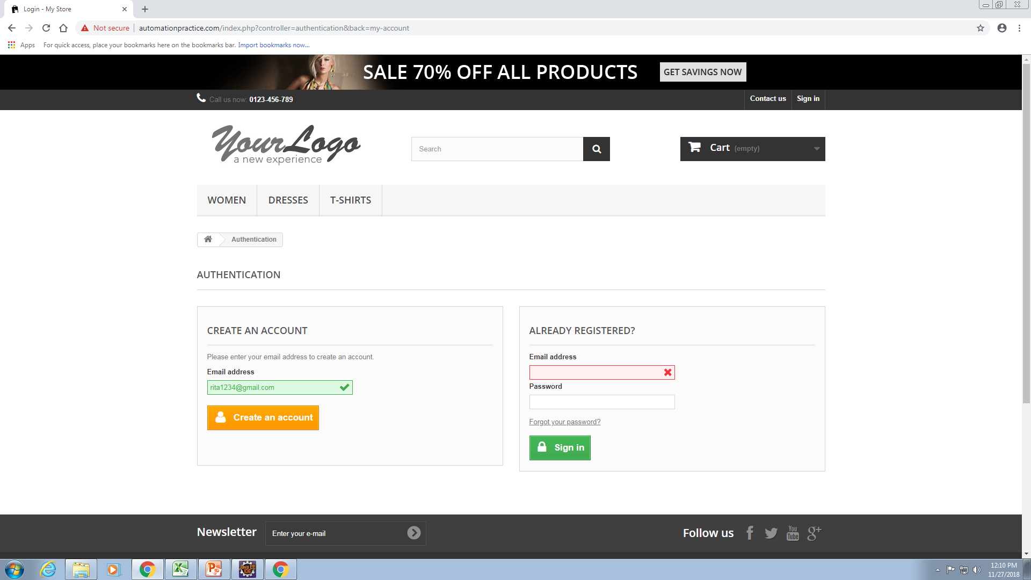
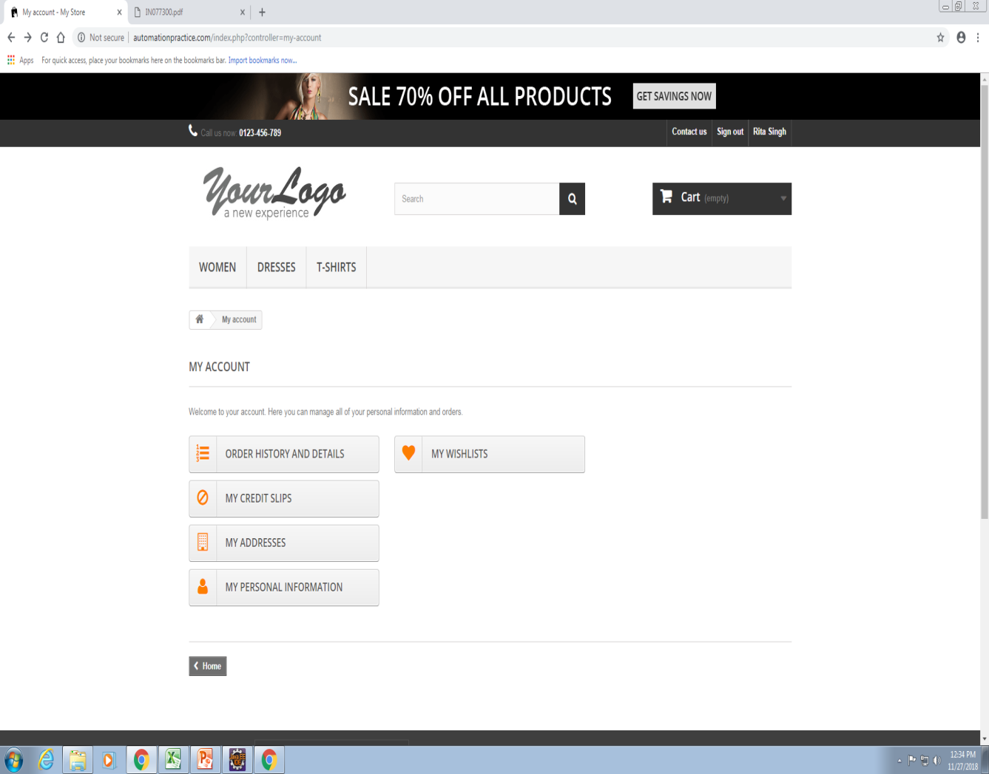
LOGIN PAGE
User Registers through email and fills the details
My Account page after login

Slide 6
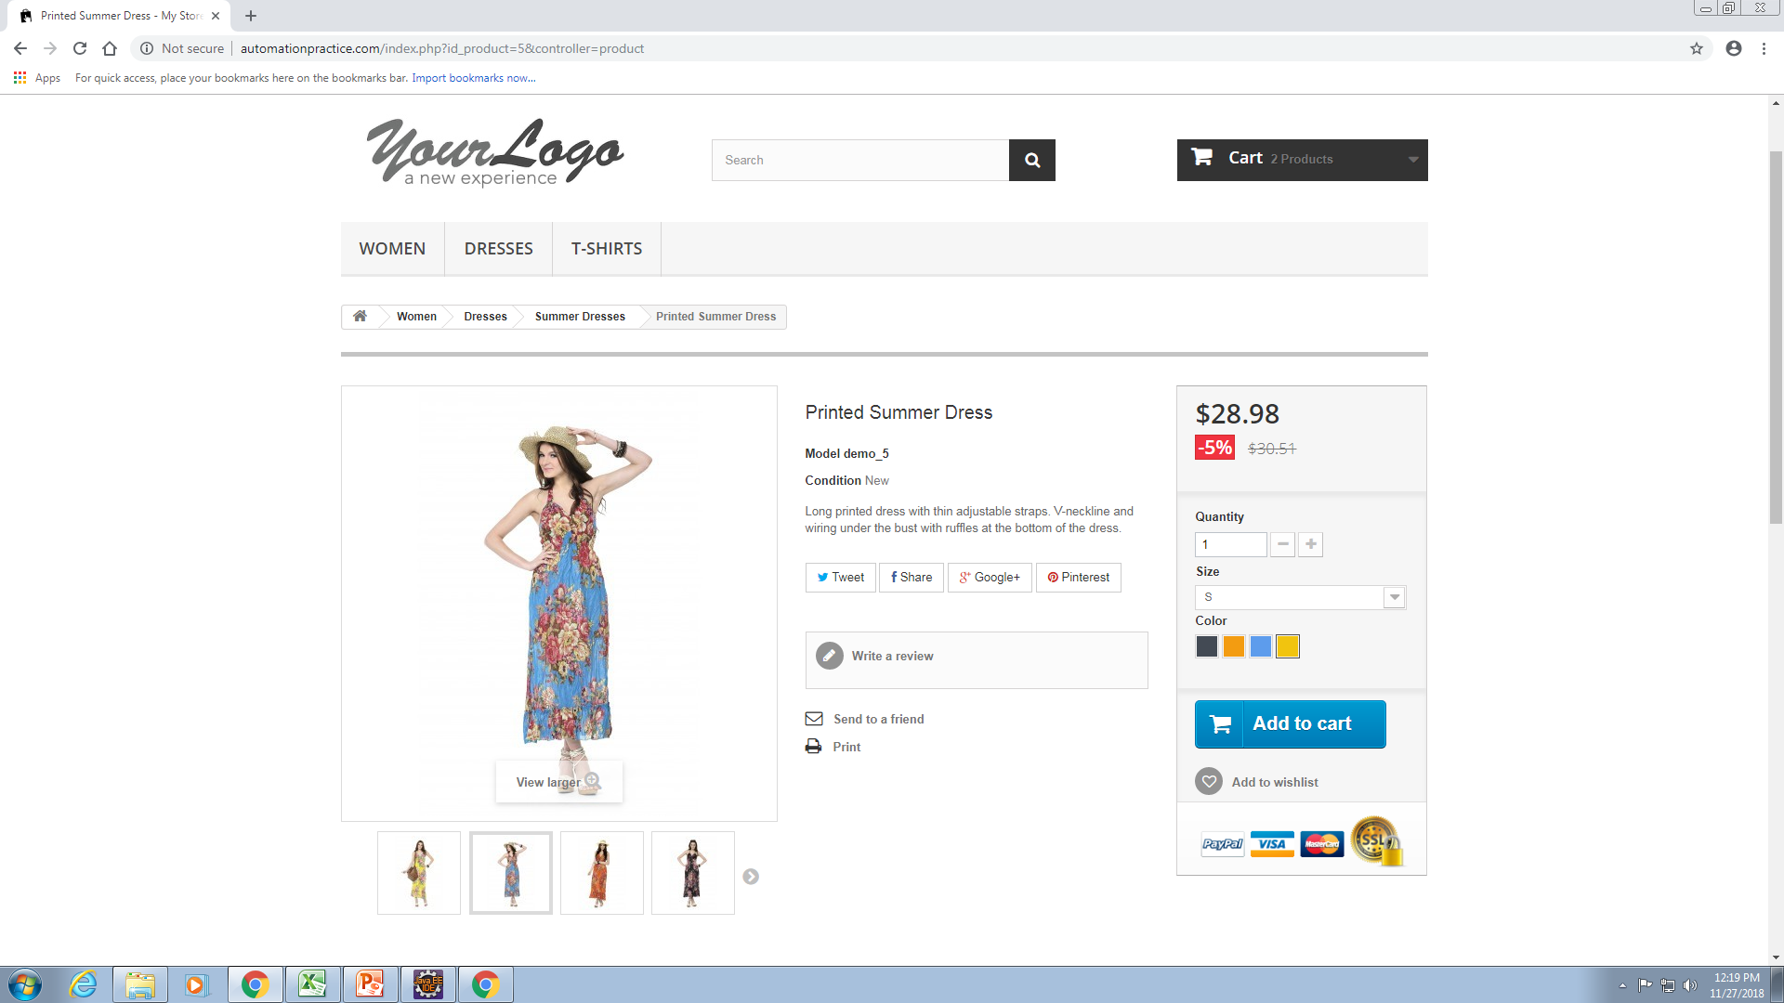

Slide 7
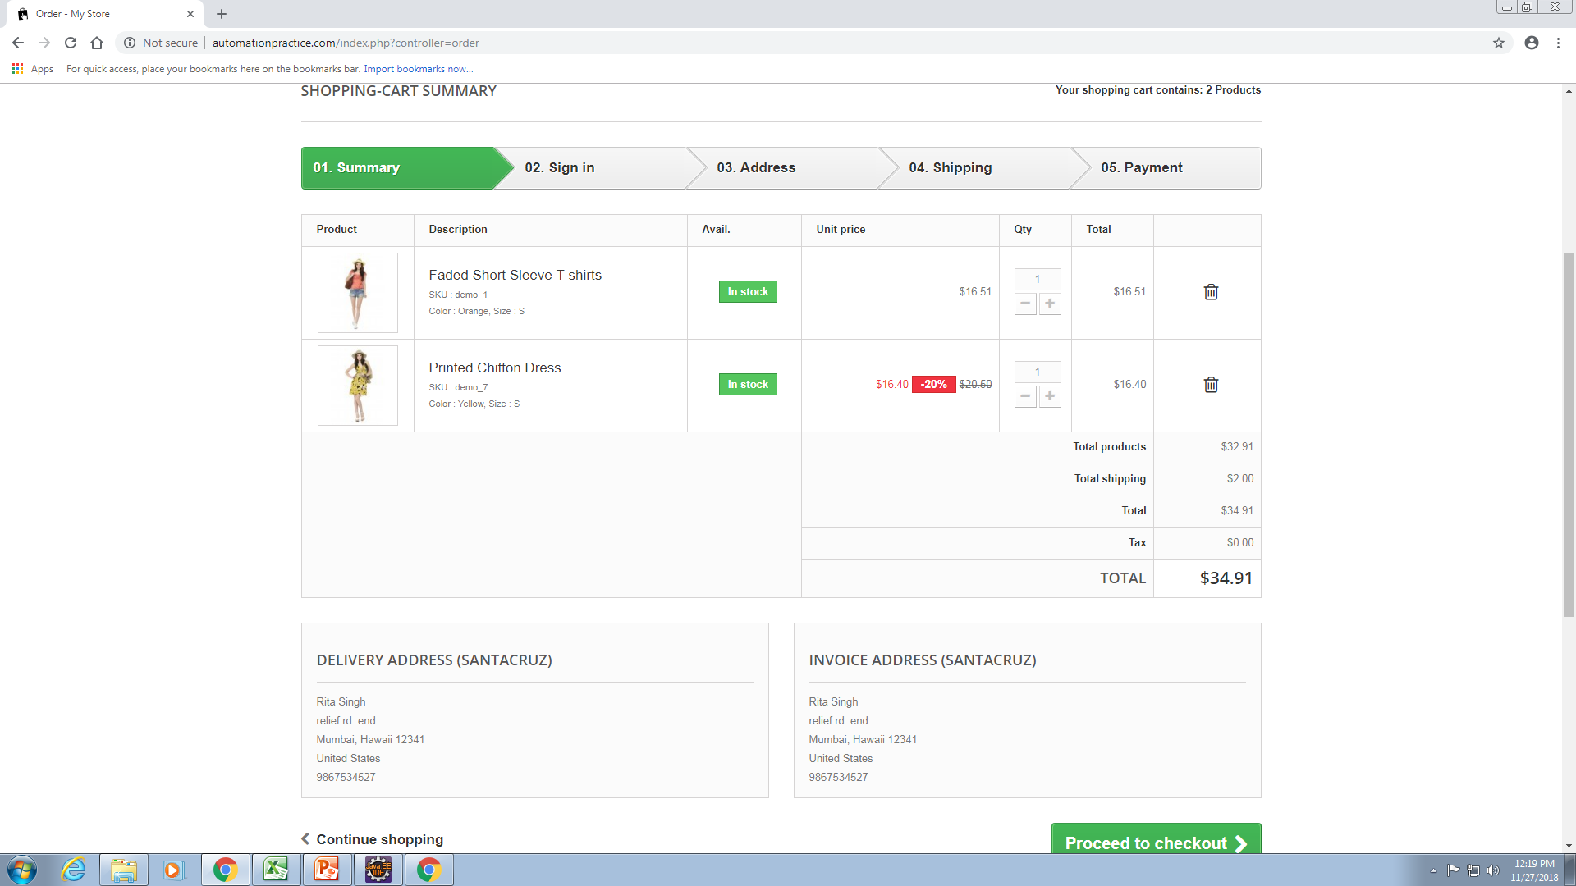
ORDER PRODUCT

Slide 8
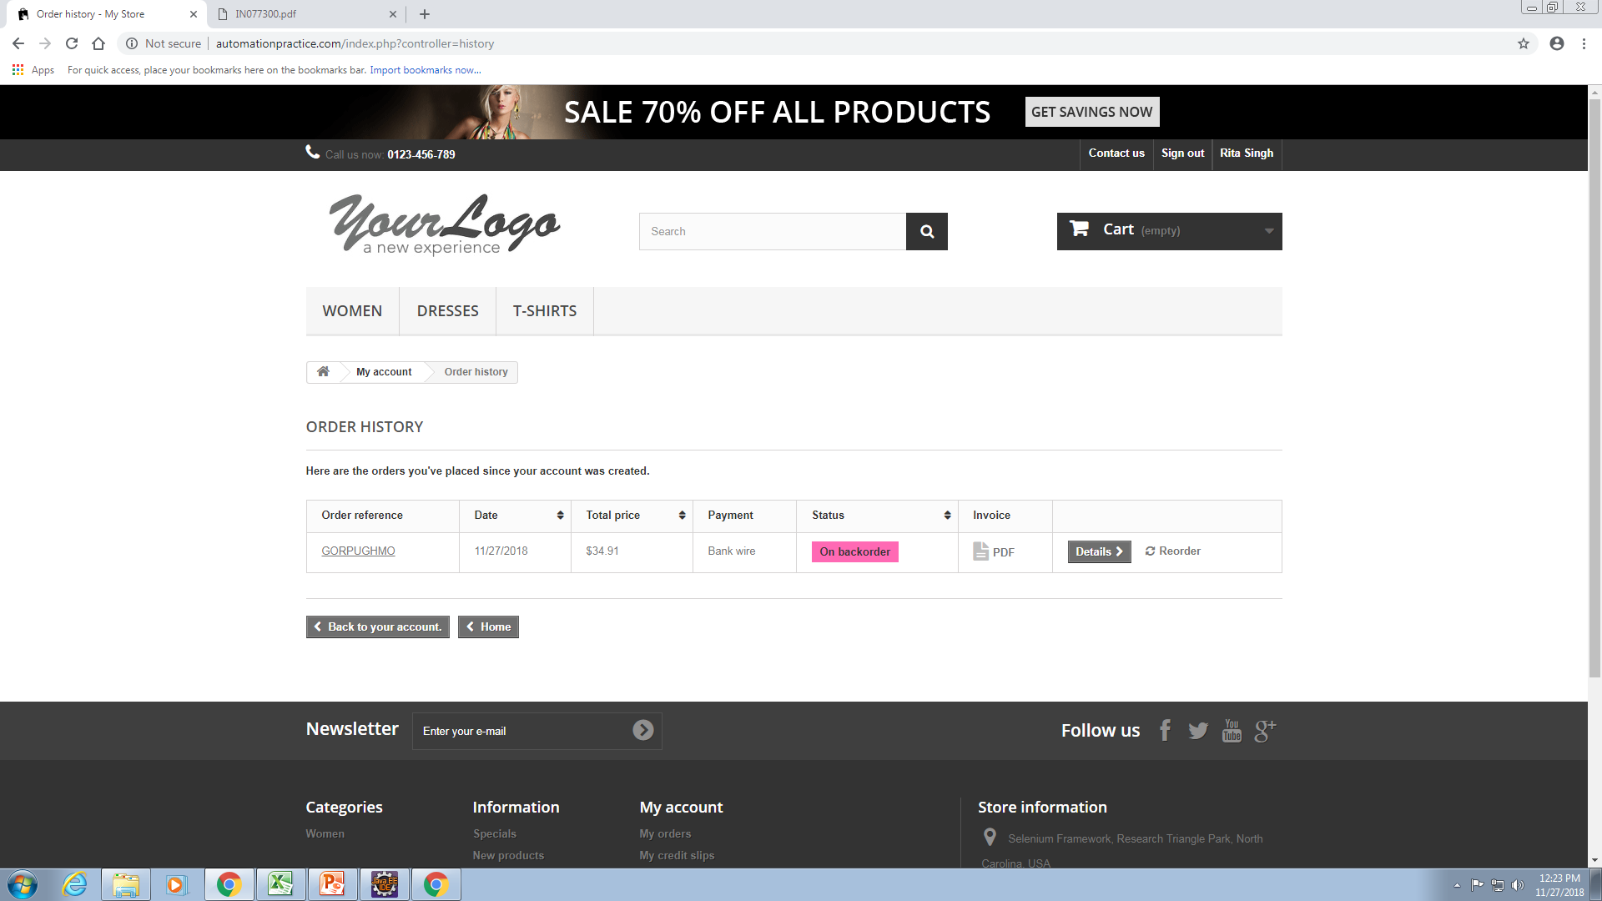
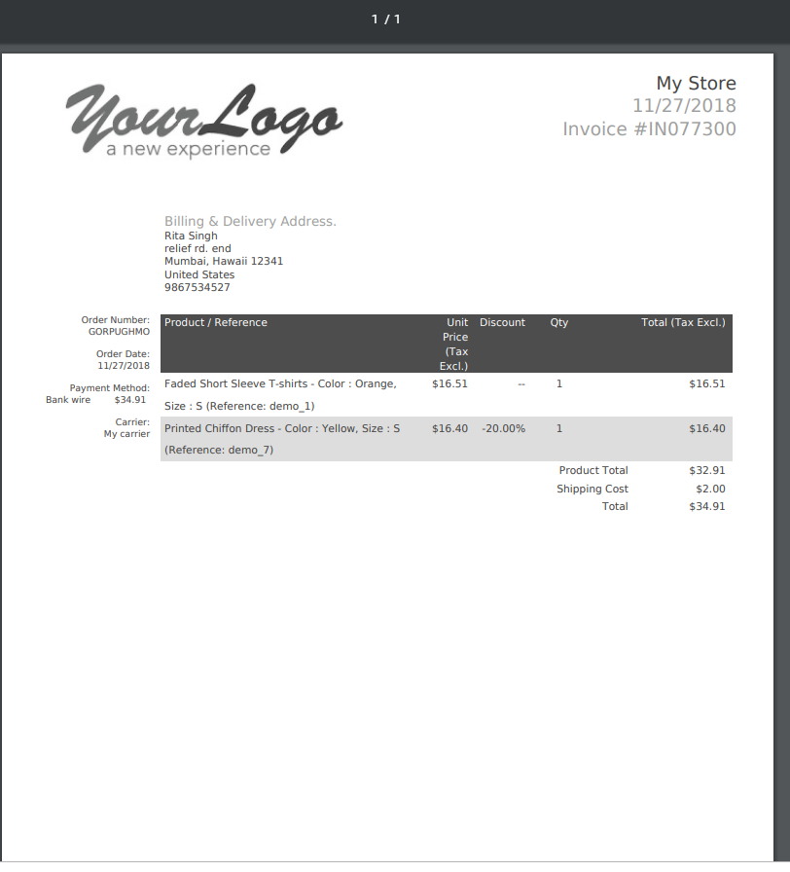
ORDER DETAILS
Page where user can download the bill
Bill

Slide 9
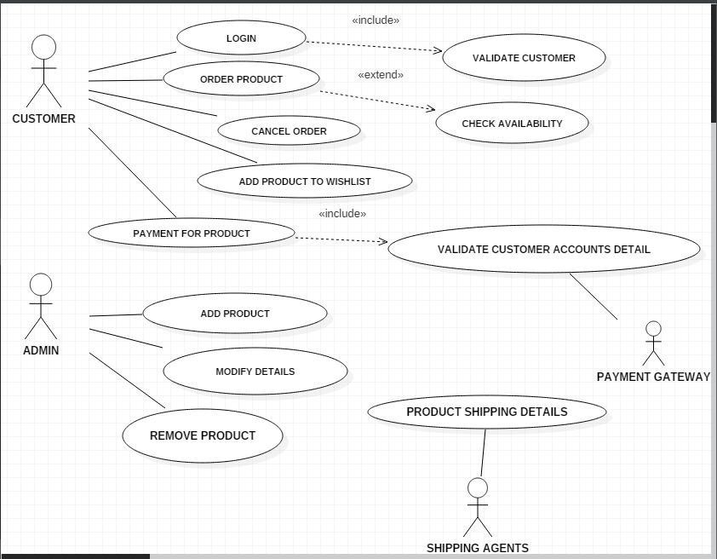
USE CASE
Login
Order Product
Cancel Order
Add Product To Wishlist
Payment For Product
Add Product
Modify Details
Product Shipping Details
Remove product

Slide 10
TEST CASES
Test Cases are divided into:
Use case
Intersystem
Security
State Transition
Functional
Cause and effect
This is the link for viewing test cases :

Slide 11
Defects Found:
This is the link for viewing the defect report:

Slide 12
CONCLUSION
Found moderate number of defects which can solved in 7-8 days.

Slide 13
Thank You

